Slide 1

South Carolina
Aeronautics Commission
Budget Request FY2019-2020

Slide 2
1. Organization
2. Accountability Report Summary
3. Budget Request
4. Proviso Summary
5. Carry Forward
6. State Aviation Fund
South Carolina Aeronautics Commission
Budget Request FY2019-2020
Table of Contents

Slide 3
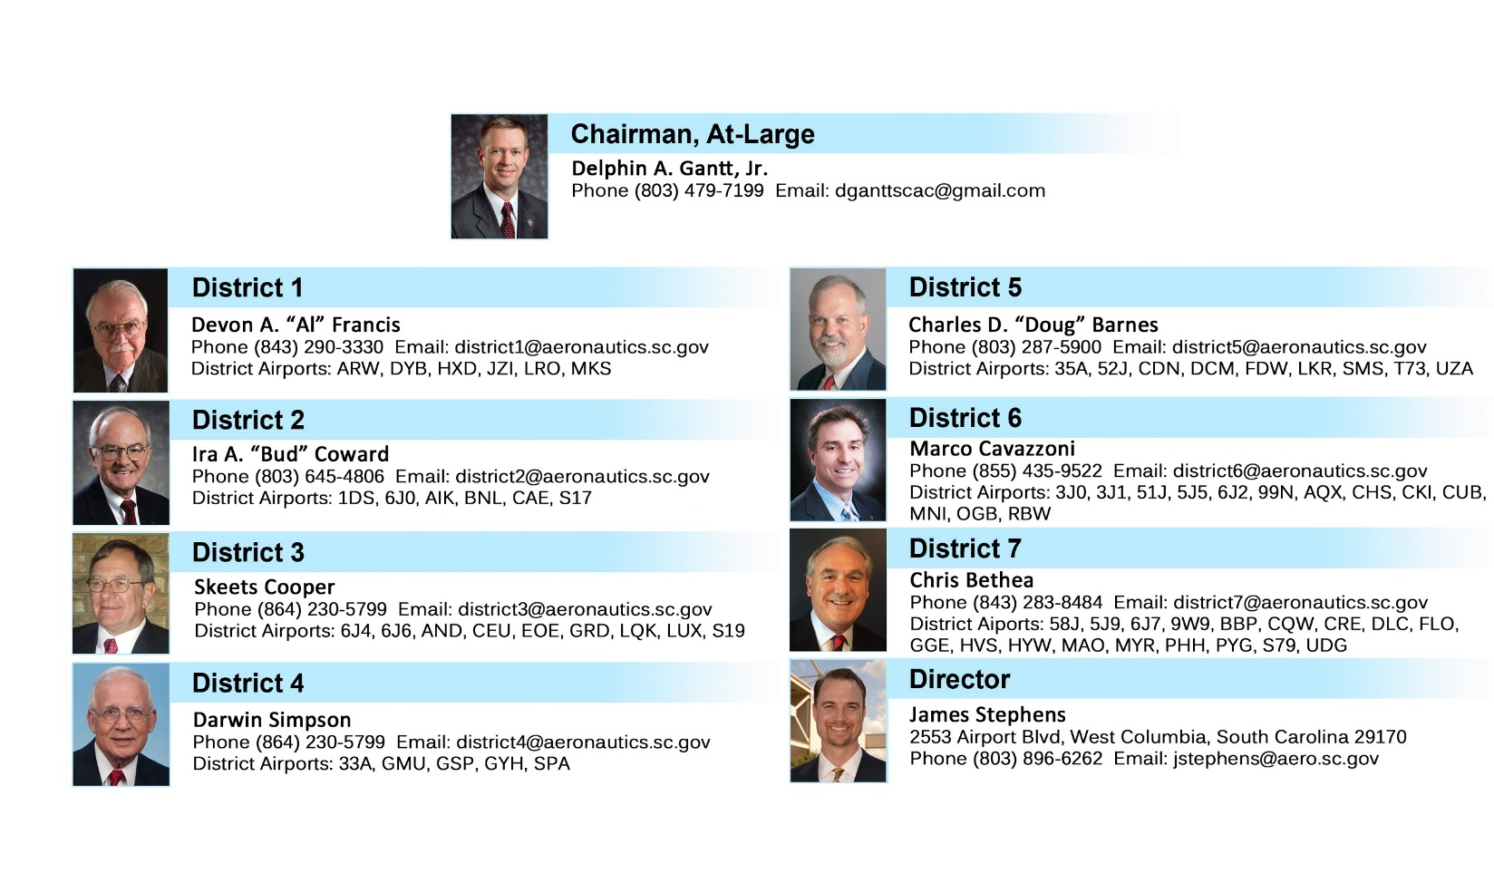
Commission Members
Agency Attendees:
James Stephens
Executive Director
Melody Mikell
Finance Director
Ericka Thomas
Office Manager

Slide 4
ORGANIZATIONAL CHART
14 FTE’s Currently Authorized
Filled, 2 Vacant, 4 Contract/Temporary
1 is in the process of being filled
.

Slide 5
Annual Accountability Report Summary
Aeronautics has approved and financially participated in twenty-seven new state funded grants totaling $3,127,004.
Aeronautics was the recipient of a new federal grant from the FAA for the Rehabilitation of Runways at the following airports: Aiken, Allendale, Bamberg, Pickens, Summerville, and Sumter. This grant also included Weather Reporting System upgrades at the Pickens and Union airports, and the installation of fencing at the Hartsville Regional Airport.
Aeronautics published and distributed the 2018 Aeronautical Chart and Airport Directory.
Aeronautics continues to inspect public use airports to ensure they maintain state and federal standards.
Aeronautics continues to provide cost effective, safe air transportation.
Aeronautics continues to serve on the SC-EMD Air Operations Branch, and assisted with post hurricane emergency response activities.
Aeronautics continues to support aviation education by promoting and financially participating in education grants for STEM based aviation education training and flight simulation training. This educational outreach has provided opportunities to thousands of students in SC, and makes students aware of the career paths that are available to them in aviation/aerospace here in SC.

Slide 6
Recurring Authorization
FY2019-2020
Aeronautics is requesting an increase in recurring authorization of Other Funds.
  $1,000,000 increase requested
  This will increase the authorization to $6M
    South Carolina’s airports continue to be successful in their efforts to secure additional Federal funding. As a result, the need for State matching money has increased, causing the need for additional authorization to spend from the State Aviation Fund. All of the funding available in the State Aviation Fund is utilized for the State’s airport system, and are managed per SC Code Section 55-5-280(C), and as approved by the South Carolina Aeronautics Commission.
    In an effort to better serve our customers, maintain the safety of our airports, improve the functionality, maintain the economic benefits, and take advantage of as many Federal grant dollars as possible, the Division is requesting this authorization increase.

Slide 7
Non-Recurring Appropriation
FY2019-2020
Aeronautics is not requesting any Non-Recurring budget changes for this fiscal year.

Slide 8
Aeronautics Proviso Request Summary
FY2019-2020

Slide 9
Aeronautics Provisos
Continued

Slide 10
Carry Forward into FY2018-2019
Fund | Fund Description | FY Ending Balance
1001 | General Fund | $149,838.79
3035 | Operating Revenue | $168,897.88
3166 | State Aviation Fund | $6,117,056.18
3958 | Sale of Assets | $1,149.55

Slide 11
Title 55 – State Aviation Fund
SECTION 55-5-280
(A)(1) All monies received from licensing of airports, landing fields, or funds appropriated for aviation grants, the tax on aviation fuel, and fees for other licenses issued under this chapter must be paid into the State Treasury and credited to the fund known as the "State Aviation Fund".
(2) The fund also may receive gifts, grants, and federal funds and shall include earnings from investments of monies from the fund.
(3) A fund balance at the close of the fiscal year shall not lapse but must be carried forward to the next fiscal year.
(4) The revenue credited to the State Aviation Fund pursuant to this subsection must be used solely as provided in subsection (C).
(B) In any fiscal year in which the tax levied by the State pursuant to Section 12-37-2410, et seq., exceeds two and one-half million dollars, the revenues in excess of two and one-half million dollars must be directed to the State Aviation Fund; however, any revenue in excess of five million dollars must be credited in equal amounts to the general fund and the State Aviation Fund.
(C) The State Aviation Fund must be used solely for:
(1) maintenance and repairs of the division's aircraft; or
(2) maintenance, rehabilitation, and capital improvements to public use airports, which may include use as matching funds for FAA Airport Improvement Grants, provided that those airports receiving grants meet the requirements set forth by the division.
(3) The State Aviation Fund must not be used for operating expenses of the division.
(D) The division may promulgate regulations governing the eligibility requirements and procedures for disbursements from the State Aviation Fund.
HISTORY: 1962 Code § 2-75; 1952 Code § 2-75; 1942 Code § 7112-20; 1935 (39) 447; 1937 (40) 595; 1938 (40) 1835; 1993 Act No. 181, § 1289, eff July 1, 1993; 2005 Act No. 11, § 1.F, eff upon approval (became law without the Governor's signature on January 13, 2005); 2012 Act No. 270, § 3, eff June 18, 2012; 2016 Act No. 239 (H.4577), § 1, eff June 5, 2016.

Slide 12
X.XXX
Aircraft (Airline) Property Tax
TO AMEND SECTION 12-37-2460 OF THE 1976 CODE, RELATING TO THE CREDITING OF AIRCRAFT PROPERTY TAXES, TO CREDIT THE PROCEEDS OF TAXES TO THE STATE AVIATION FUND; AND TO AMEND SECTION 55-5-280, RELATING TO THE STATE AVIATION FUND, TO MAKE A CONFORMING CHANGE.
Be it enacted by the General Assembly of the State of South Carolina:
SECTION 1. Section 12-37-2460 of the 1976 Code is amended to read:
"Section 12-37-2460. The proceeds collected under this article shall be paid into the general fund of the State Aviation Fund."
SECTION 2. Section 55-5-280 of the 1976 Code is amended to read:
"Section 55-5-280. (A)(1) All monies received from licensing of airports, landing fields, or funds appropriated for aviation grants, the tax on aviation fuel, and fees for other licenses issued under this chapter must be paid into the State Treasury and credited to the fund known as the 'State Aviation Fund'.
(2) The fund also may receive gifts, grants, and federal funds and shall include earnings from investments of monies from the fund.
(3) A fund balance at the close of the fiscal year shall not lapse but must be carried forward to the next fiscal year.
(4) The revenue credited to the State Aviation Fund pursuant to this subsection must be used solely as provided in subsection (C).
(B) In any fiscal year in which the tax levied by the State pursuant to Section 12-37-2410, et seq., exceeds two and one-half million dollars, the revenues in excess of two and one-half million dollars must be directed to the State Aviation Fund; however, any revenue in excess of five million dollars must be credited in equal amounts to the general fund and the State Aviation Fund.
(C) The State Aviation Fund must be used solely for:
(1) maintenance and repairs of the division's aircraft; or
(2) maintenance, rehabilitation, and capital improvements to public use airports, which may include use as matching funds for FAA Airport Improvement Grants, provided that those airports receiving grants meet the requirements set forth by the division.
(3) The State Aviation Fund must not be used for operating expenses of the division.
(D)(C) The division may promulgate regulations governing the eligibility requirements and procedures for disbursements from the State Aviation Fund."
SECTION 3. This act takes effect upon approval by the Governor and first applies to Fiscal Year 2018-
2019.

Slide 13
State Aviation Fund Budget Projections
 | Expected Commitments for FY2019-2020
Expected New Grant Commitments | 2,700,000 *
Expected New Terminal Funding Requests | 500,000
State Sponsored Federal Match | 350,000
State Aviation Maintenance Projects | 1,500,000
State Aviation Administration Projects | 500,000
State Aviation Support Services | 500,000
TOTAL PROJECTED COMMITMENTS | 6,050,000
* New Commitments includes the anticipated Federal FY2019 airport CIP’s, and State/Local projects. * Have multi-year life-cycles that can span up to four years. These funds are used as matching funds for Federal Aviation Administration grants, and Capital Improvements that may not be federally eligible.

Slide 14
State Aviation Fund Revenue
Total Annual Revenue (FY17/18): $4,283,026.29

